Slide 1
AI
Question Answering
Apple
E
presented by
Arvio Abe Suhendar

Slide 2


Problem Statement
E
  Information about the iPhone is scattered across many sources.
  It's hard to find a concise and accurate answer.
  Relevant automated QA system is needed & can work 24 hours

Slide 3
Features
E
  The dataset is saved in CSV format
  Answering questions about Apple products
  Simple interface using Streamlit
  Using RAG to combine retrieval + LLM models

Slide 4

E
  Create an iPhone-specific Q&A system.
  Using the RAG (Retrieval + LLM) approach.
  Provide accurate document-based answers.
Objective

Slide 5

E
RAG Architecture
Load Dataset
Cleaning Data
Convert CSV to Document
Chunking: breaking large text into smaller parts
Embedding : convert text to number vector
Vector Store : Saves a vector of numbers to a vector database
Retriever: searches the vector database for the most similar result to retrieve.
LLM : Processing answers from similarity context from retriever

Slide 6

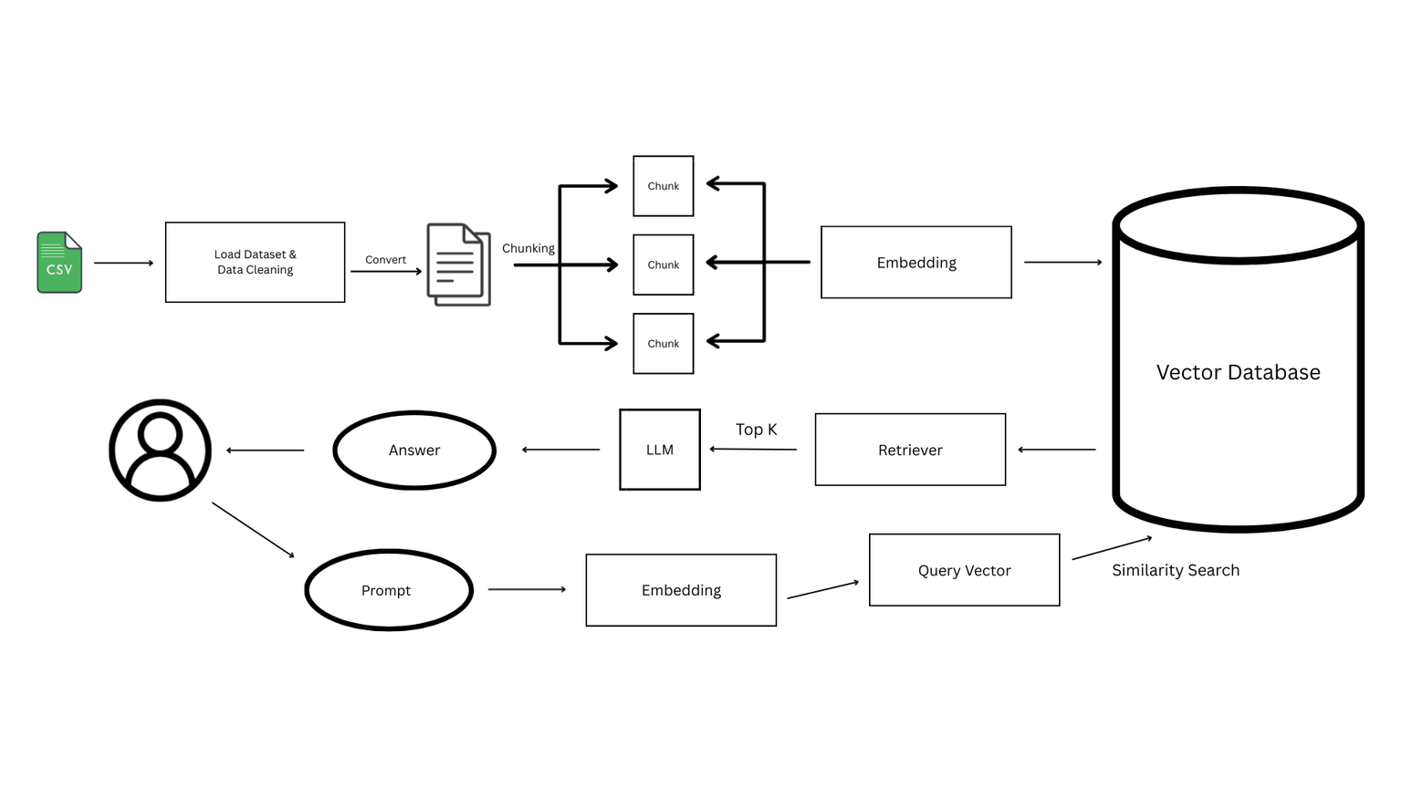
E
Diagram
  Users ask question
  The system searches for relevant documents in the database.
  Documents + questions sent to LLM.
  LLM produces answers.

Slide 7

E
Dataset : apple.csv
E
Total Records : 1002
Features
  Question : Questions about Apple products
  Answer : Answers to questions about apple products asked
Dataset Overview

Slide 8
E
Python
Langchain
Streamlit
Chromadb
Pandas
LLM Model : llama3
Embedding Model : Qwen/Qwen3-Embedding-0.6B
Tools & Library

Slide 9
E
Results and Evaluation
Following are some questions and how the model can answer them.
Can i use calculator on iphone and how ?
According to the previous questions and answers, you can use the Calculator app on an iPhone by:
  Opening the Calculator app.
  Using the standard calculator interface to perform basic arithmetic operations (addition, subtraction, multiplication, and division).
  Swiping to the left to reveal a scientific calculator with more advanced functions. So, to answer your question: To use the calculator on your iPhone, open the Calculator app and start performing calculations using the basic or scientific calculator interfaces!

Slide 10
E
Results and Evaluation
Following are some questions and how the model can answer them.
How to check RAM of a mac ?
According to the provided context, to check the amount of RAM in your Mac: Helpful Answer: Click on the Apple menu and select "About This Mac", it will display the amount of RAM.
Can I use keyboard and mouse for apple TV ?
According to the provided context, it seems that: Yes, you can pair a Bluetooth keyboard and mouse with your Apple TV.
From these results, it can be concluded that the model can answer questions according to the context asked well and appropriately.

Slide 11
E
Contribution
Using larger and more complex datasets
Experimenting with different LLM models
Refining the design of streamlit to make it even better

Slide 12
Conclusion
IPhone QA RAG can answer iPhone questions quickly & relevantly.
E
The Retrieval + LLM approach improves the accuracy of the answers.
Still needs development: data updates, multi-language, and official API integration.

Slide 13
About Me
I am currently learning and building a career in AI/ML. This project is my practice to build a simple python application. I want to further develop my skills in this field through existing projects.
E
Email
Github
4rv10suhendar@gmail.com
arvio1378
Linkedin
Arvio Abe Suhendar

